Slide 1

eBanking Smart & Secure

Slide 2
This case study will explore how one of the FinTech Start Ups is using open banking framework to make it convenient and secured for subscribers to connect to and initiate payments between various banks with ease.

Slide 3

OverView & ORIGIn
Company: YAPILY
Founded in mid-2017 by Stefano Vaccino
Provides Open Banking API to help financial service providers to communicate with banks.
Raised $5.4 Million in exchange for equity stake in the company.
Funded by HV Holtzbrinck Ventures and LocalGlobal.
Other investors are Taavet Hinrikus (Co-founder of TransferWire), Ott Kaukver(CTO of Twillo) and Roberto Nicastro (ex-deputy CEO of UniCredit)
Provides secure API framework to initiate payments and access bank informations.

Slide 4
Business Activities
Origin
Yapily
EU created an objective to provide unified payment so all local and international non-cash transactions can be handled with ease.
Open Banking Working Group (OBWG) publish The Open Banking Standard. It provides guidelines on how to create, share and consume open banking data.
As the regulations made it easier for third parties to provide new services by accessing customer bank information, services like One-click-away has become easier and efficient.
In January 2018 EU implemented Payment Service Directive 2 or PSD2, which mandates banks provide user financial data.
Allow service providers to connect to their banks for both data access and to make payments through a secure single API.
Wants to position as a technology enabler by providing tools that an enterprise needs to easily manage their connectivity layer.
Uses technologies like Python, Node.js, Java, JSON
Supports Basic HTTP Authentication and Token based Authentication

Slide 5
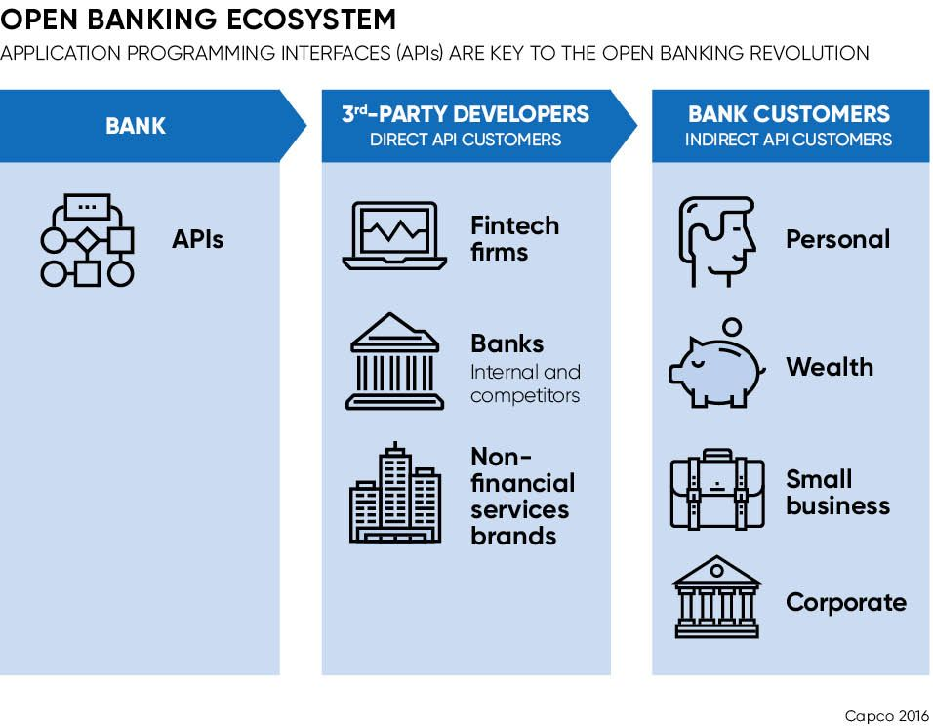
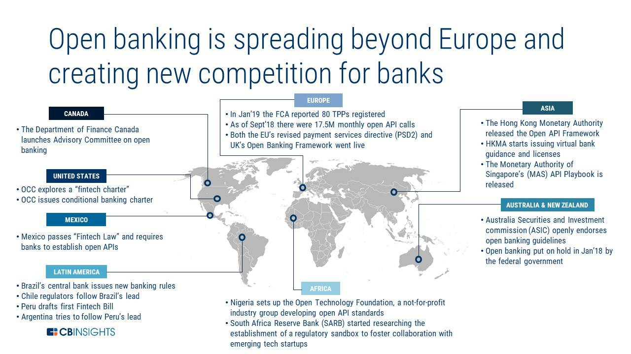
Landscape

Slide 6
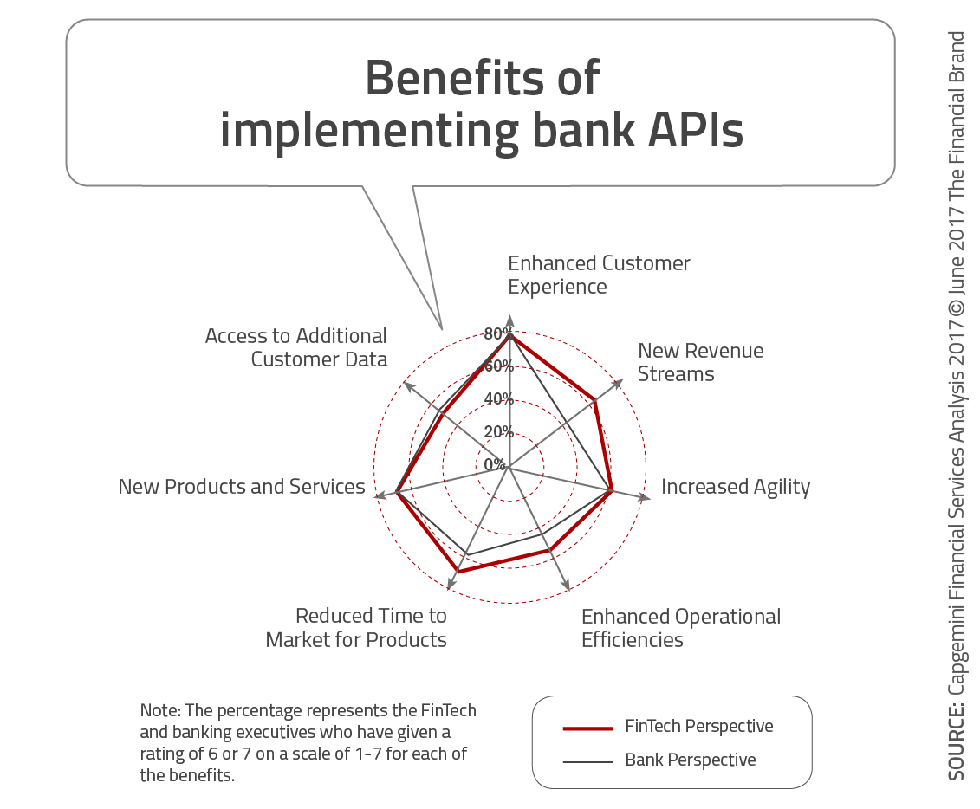
Landscape
Other competitors
Plaid
Tink
MX – Fintech Product
Utrust
HaveLife Insurance

Slide 7
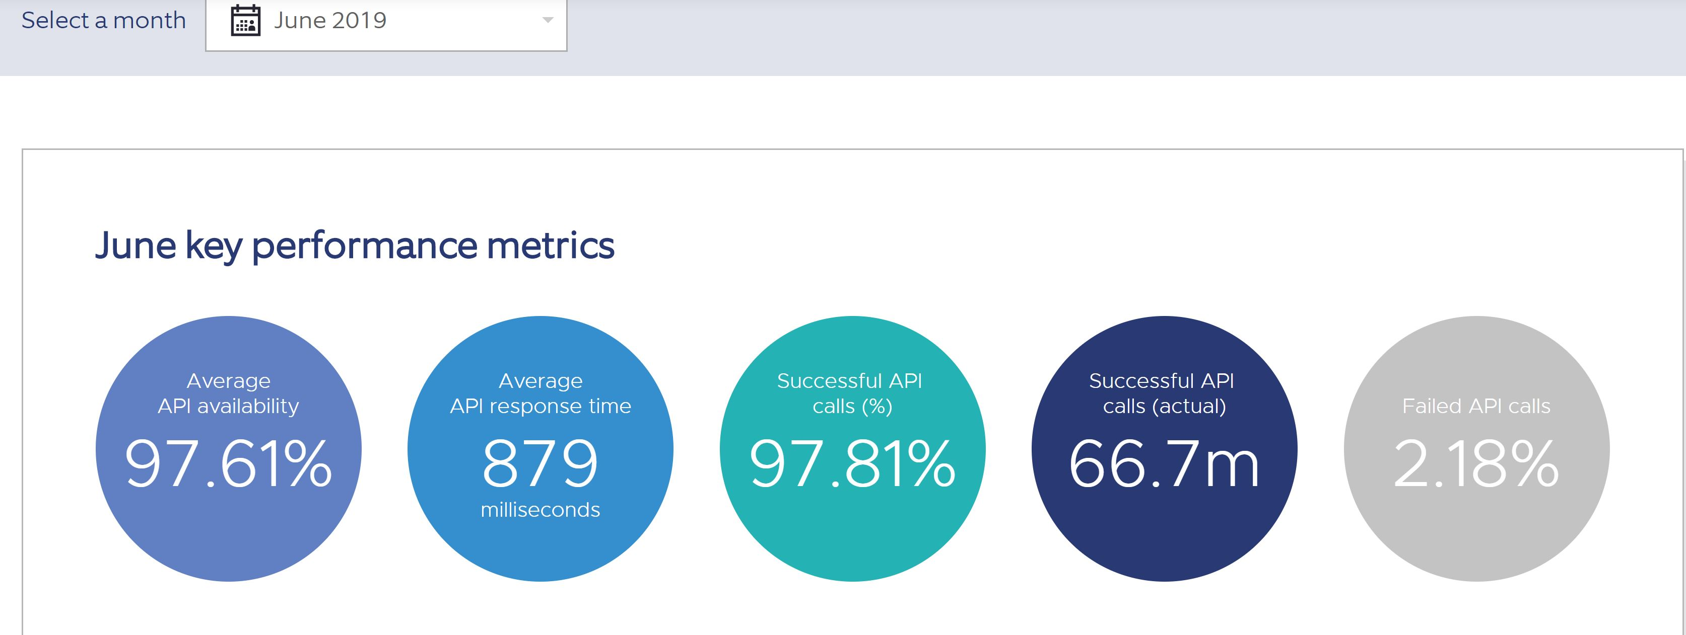
Results
A Few metrics used by companies to determine their performance
Yapily supports 35 biggest bank in EU.
Equivalent to 250 million bank accounts.
Planning to connect to 536 more banks as they expose their APIs adhering to EU’s PSD2 legislation.

Slide 8
Recommendations
Use Blockchain for secure API calls
Using of Blockchain will provide opportunity to use cryptocurrency for non-cash transactions.
Use Machine Learning or Artificial Intelligence to provide bots to analyze user’s retrieved data and recommend various financial products.

Slide 9

THANK YOU
Manpreet Singh Padam

